Slide 1
Student Welfare Portal
Team Members:
G Arshad
Kaustubh Pandey
Rishav Chandra Varma
Vishal Prasad
Wasim Ishaq Khan

Slide 2
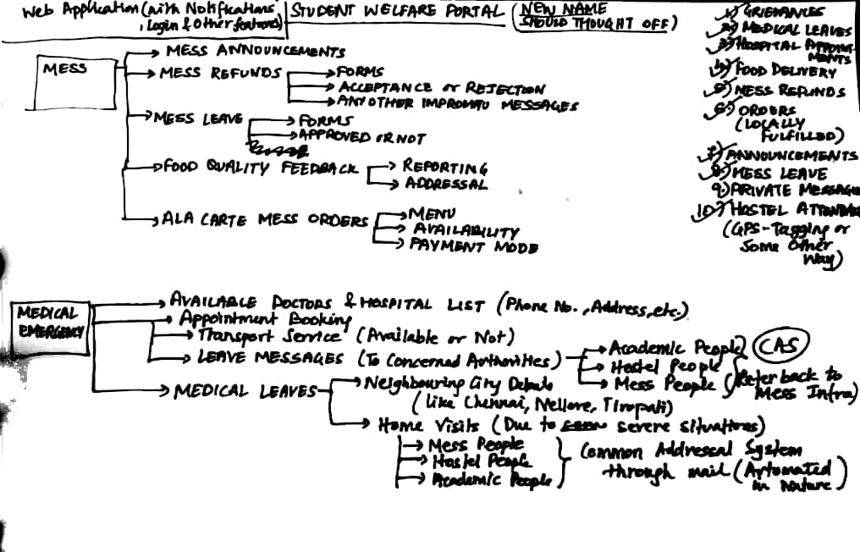

Slide 3
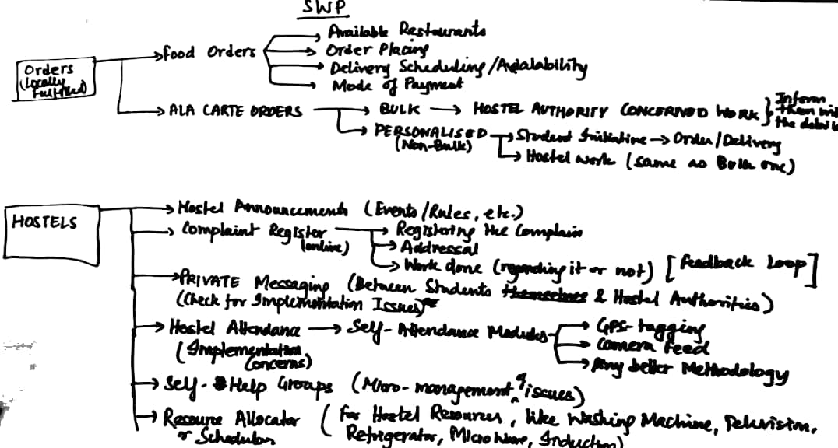

Slide 4
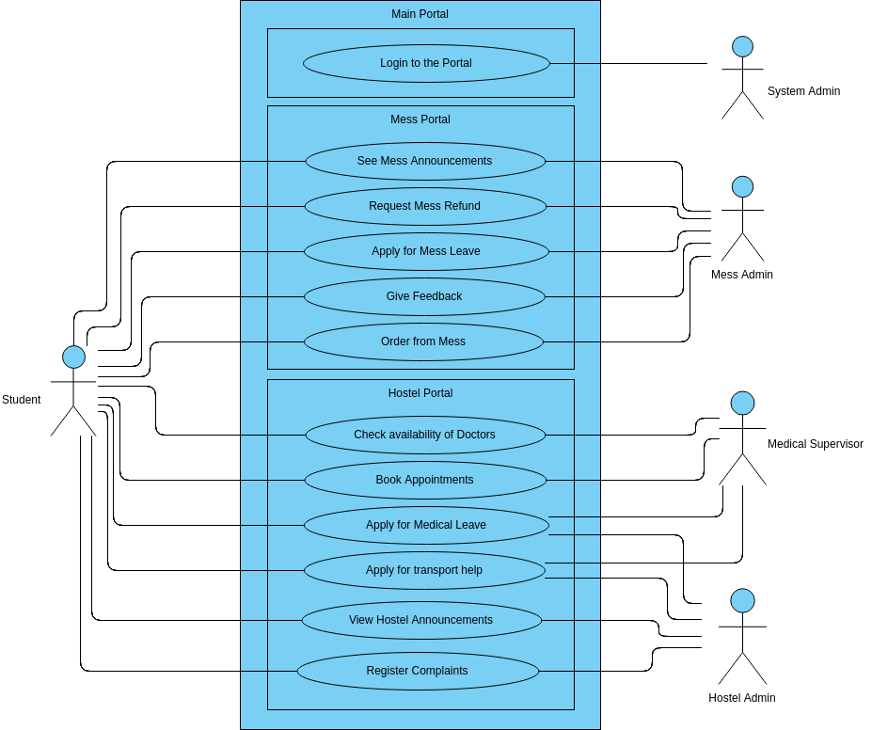

Slide 5
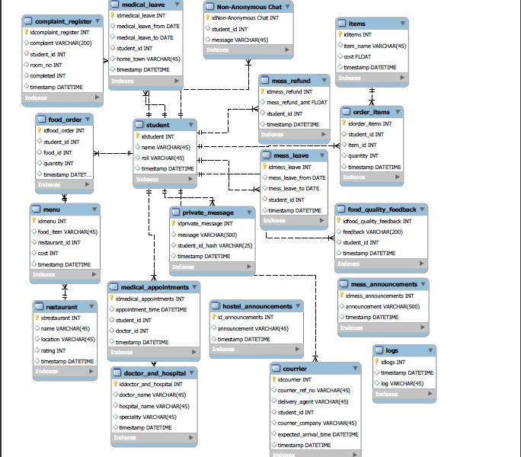

Slide 6
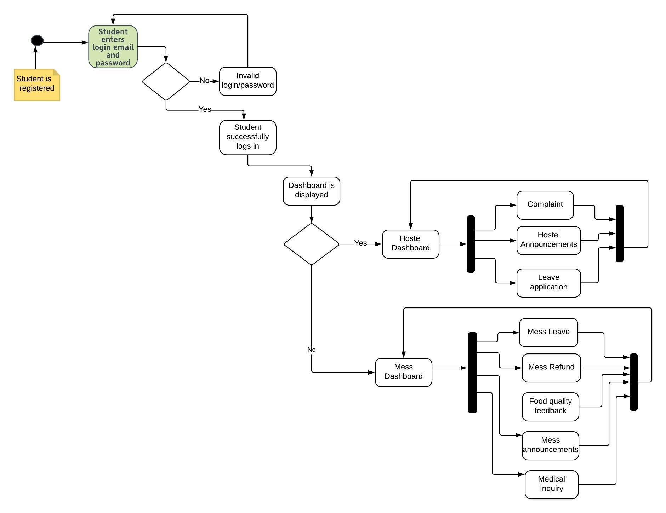

Slide 7
Thank You All !!

